Slide 1
JUNO and Neutrino Geo-Science
江门中微子实验和中微子地球科学
李玉峰
liyufeng@ihep.ac.cn
Institute of High Energy Physics, Beijing
中科院高能所
Dec. 20, 2019@清华大学

Slide 2
中微子：作为基本粒子的角色

Slide 3
中微子：作为宇宙信使的角色

Slide 4
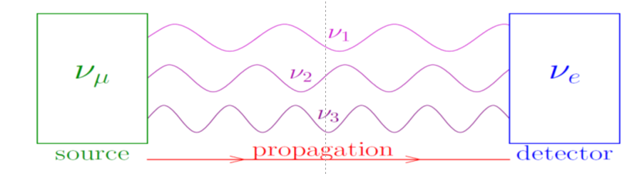

中微子振荡-I

Slide 5
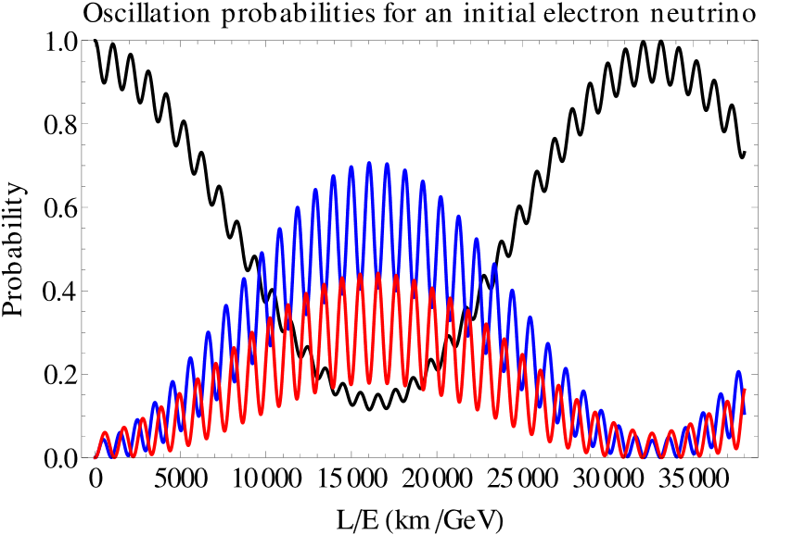
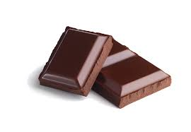
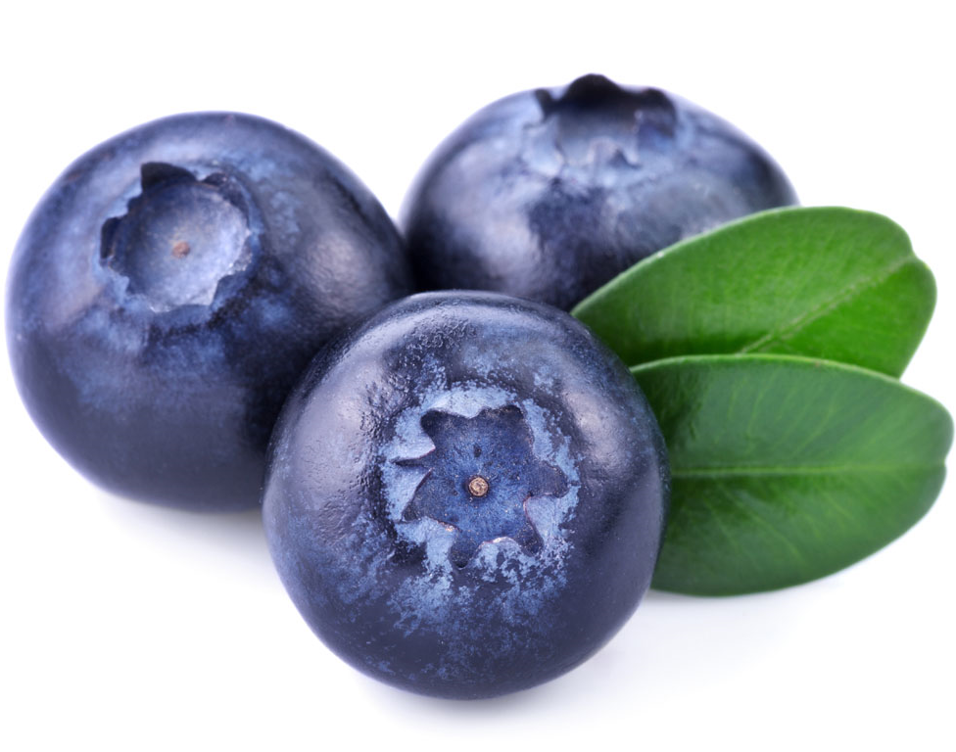

中微子振荡-II
ν_{e}
ν_{μ}
ν_{τ}

Slide 6
太阳中微子振荡

Slide 7
大气中微子振荡

Slide 8
反应堆中微子振荡

Slide 9
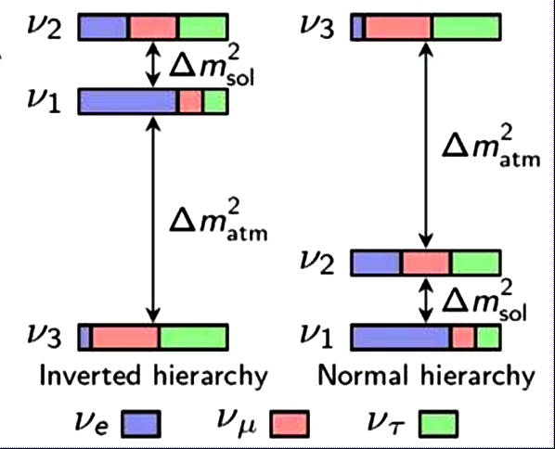


中微子质量和轻子味混合
大气中微子
加速器中微子
反应堆中微子加速器中微子
太阳中微子
反应堆中微子
$$2.4∙{10}^{−3}{eV}^{2}$$
$$7.5∙{10}^{−5}{eV}^{2}$$

Slide 10
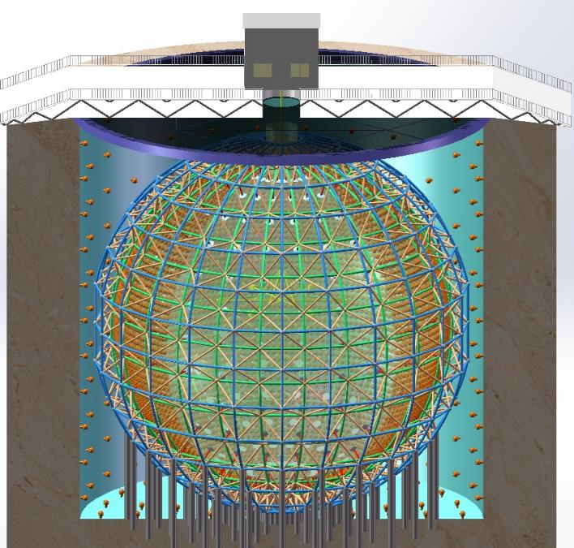
江门中微子实验
Jiangmen Underground Neutrino Observatory (JUNO)
20 kton LS detector
3% energy resolution
700 m underground
Rich physics possibilities
  Reactor neutrino
  for Mass hierarchy
  Precision measurement of oscillation parameters
  Supernovae neutrino
  Geoneutrino
  Solar neutrino
  Atmospheric neutrino
  Exotic searches including proton decay, dark matter
JUNO has been approved in Feb. 2013. ~ 300 M$ by China
Neutrino Physics with JUNO, J. Phys. G 43, 030401 (2016)

Slide 11
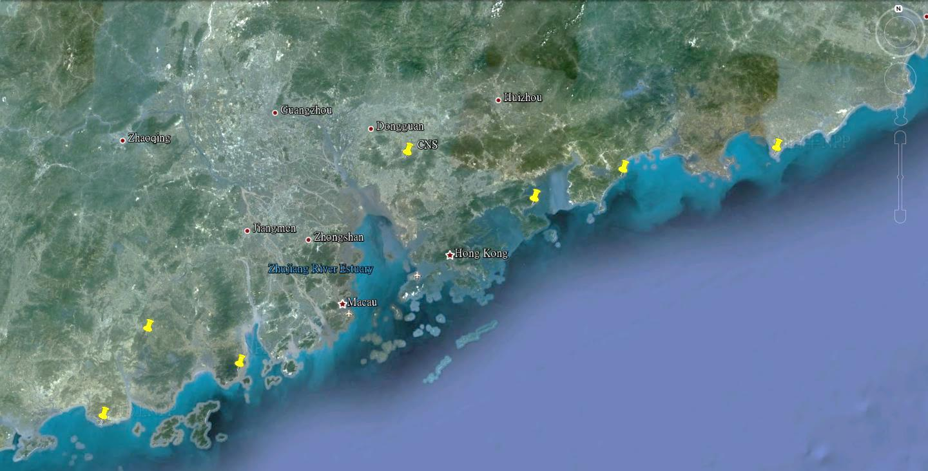

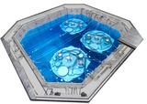
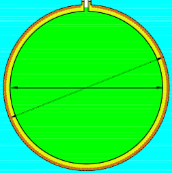
江门中微子实验
NPP | Daya Bay | Huizhou | Lufeng | Yangjiang | Taishan
Status | Operational | Planned | Planned | Under construction | Under construction
Power | 17.4 GW | 17.4 GW | 17.4 GW | 17.4 GW | 18.4 GW
by 2020: 26.6 GW
Overburden ~ 700 m
Previous site candidate
Kaiping,
Jiang Men city,
Guangdong Province
Guang Zhou
2.5 h drive
Lufeng
NPP
Shen Zhen
Huizhou
NPP
Zhu Hai
Daya Bay NPP
Hong Kong
53 km
Macau
53 km
Taishan NPP
Yangjiang NPP

Slide 12
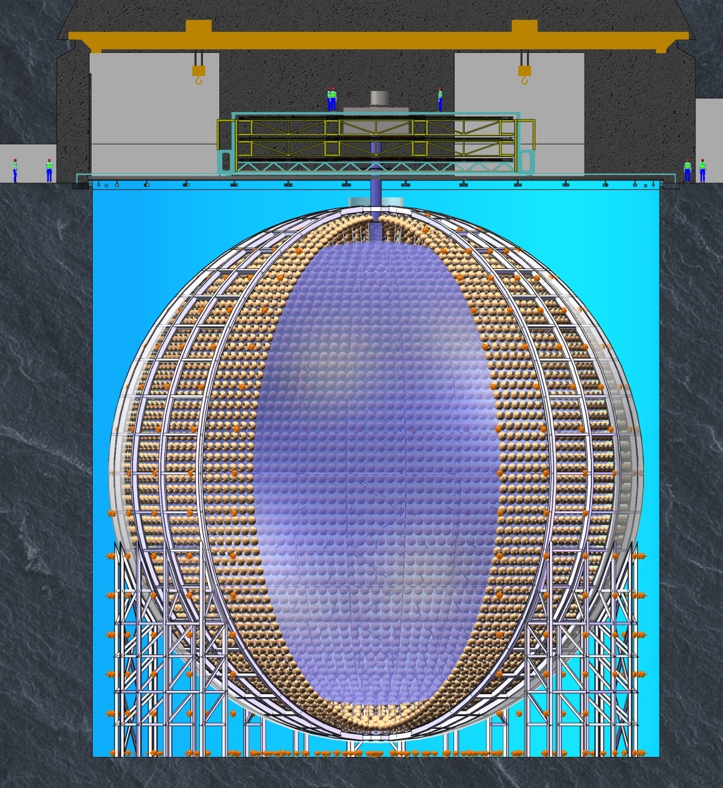
JUNO 探测器
Calibration room
LS Filling room
Pure water room
Central detector
Acrylic sphere
Stainless-steel truss
Acrylic sphere: Φ35.4m
Top Tracker
CD PMT
~18,000 20” PMTs
+ ~25,000 3” PMTs:
Stainless steel latticed shell: Φ40.1m
Pool depth: 44m
Water Cherenkov
35 kton pure water
2,000 20” veto PMTs
Liquid scintillator
20 kton
Water pool: Φ43.5m

Slide 13
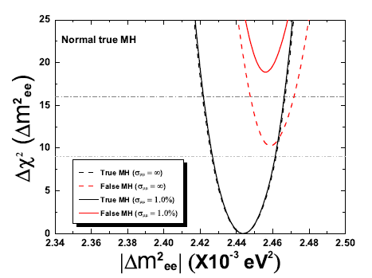
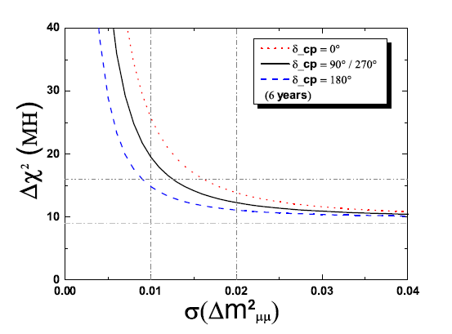
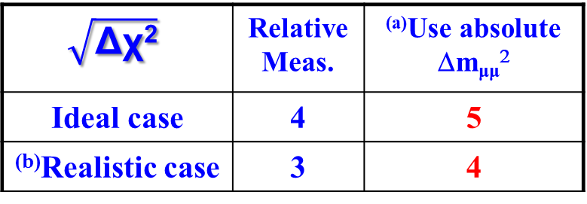
质量顺序的灵敏度
JUNO MH sensitivity with 6 years' data:
$$\sqrt{\text{Δχ}\text{2}}$$ | Relative Meas. | ^{(a)}Use absolute Δm_{μμ}²
Ideal case | 4 | 5
^{(b)}Realistic case | 3 | 4
Y.F Li et al
PRD 88, 013008 (2013)
^{(a)} If accelerator experiments, e.g NOvA, T2K, can measure Δm²_{μμ} to ~1% level
^{(b)} Take into account multiple reactor cores, uncertainties from energy non-linearity, etc
 | Ideal | Core distr. | DYB & HZ | Shape | B/S (stat.) | B/S (shape) | |Δm²_{μμ}|
Size | 52.5 km | Real | Real | 1% | 6.3% | 0.4% | 1%
Δχ²_{ΜΗ} | +16 | - 3 | -1 | - 1 | - 0.6 | - 0.1 | + (4-12)

Slide 14
多目标的地下中微子望远镜

Slide 15

地球中微子：地球内部的探针

Slide 16
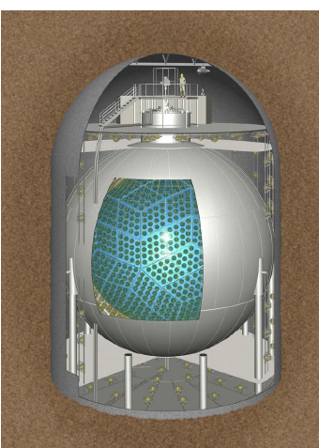
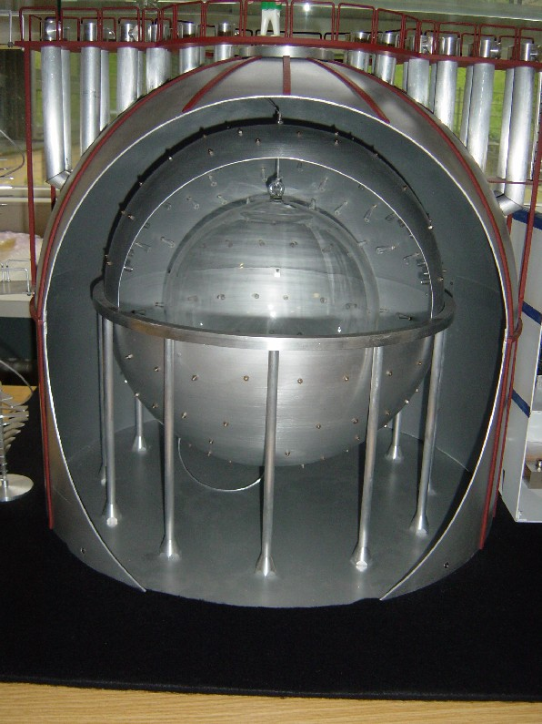
地球中微子的实验现状
First observed in 2005 by KamLAND, then in 2010 by Borexino
KamLAND, Japan (1kt)
Borexino, Italy (0.6kt)
~1 event/30 days
~1 event/70 days

Slide 17
Borexino实验结果 (2019) arXiv: 1909.02257
TNU: one event per 10³² free protons (~ a kiloton) per year

Slide 18
KamLAND实验结果 (2019)
From Hiroko Watanabe
Nu-Geoscience (2019)

Slide 19
KamLAND v.s. Borexino
From Hiroko Watanabe Nu-Geoscience (2019)
Experimental uncertainty: KamLAND 15% v.s. Borexino 18%
Crustal model uncertainty: KamLAND 10% v.s. Borexino 19%
Reliable and accurate prediction of crustal signal is critical !

Slide 20
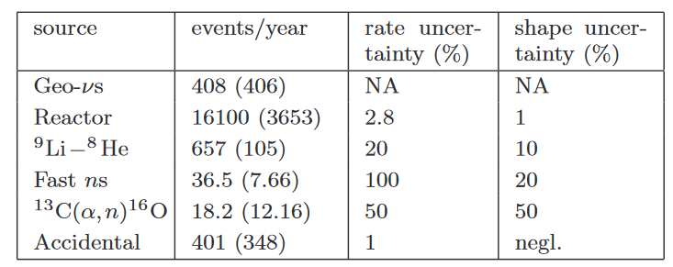
江门实验的地球中微子信号
From Han, YFL et al. CPC (2016)
~400 events/year is much larger than current measurements.
Reactor neutrinos !
Need better understanding the spectral shape.
Daya Bay & JUNO-TAO

Slide 21
江门实验地球中微子的测量精度
Fix Th/U ratio
Free Th/U ratio
Total signal 14% (1 year), 5% (10 year)
U signal: 15%; Th signal: 30%
An accurate crustal model is needed for the mantle signal measurement!
See the next talk by Ran Han

Slide 22
需要构造精确&可靠的局域地壳模型
Strati et al. (2015)

Slide 23
JUNO时间表
2021

Slide 24
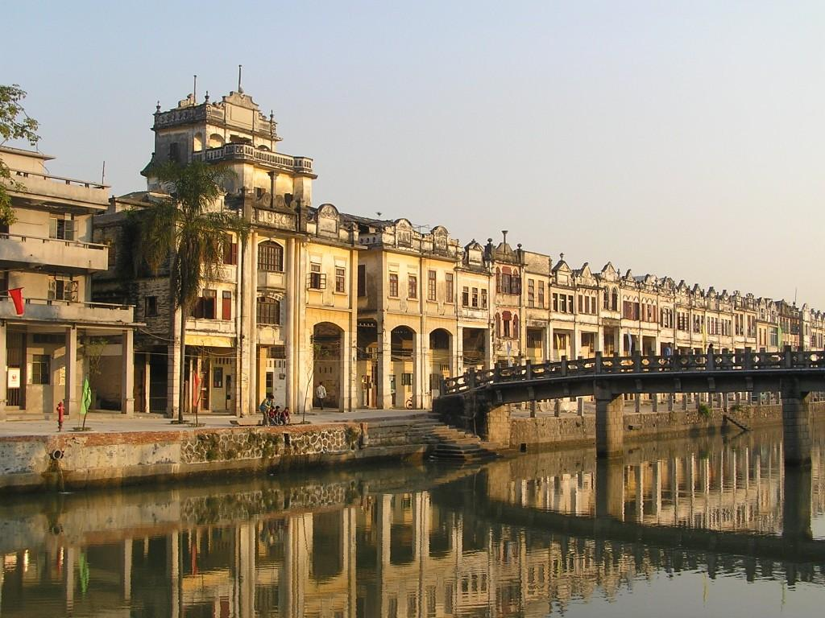
Thanks
Welcome to
JUNO@广东省江门市开平市

Slide 25
Backup

Slide 26
Go 700 m Underground
Slope tunnel
1340m
Vertical shaft
581m
Groundbreaking on Jan 10, 2015

Slide 27
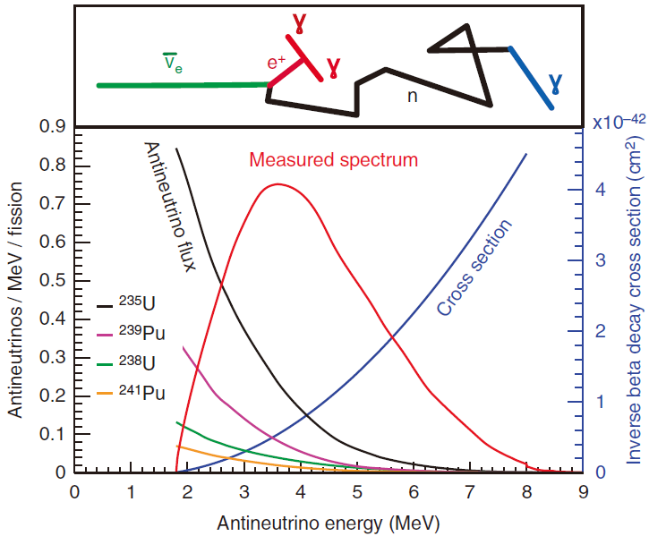
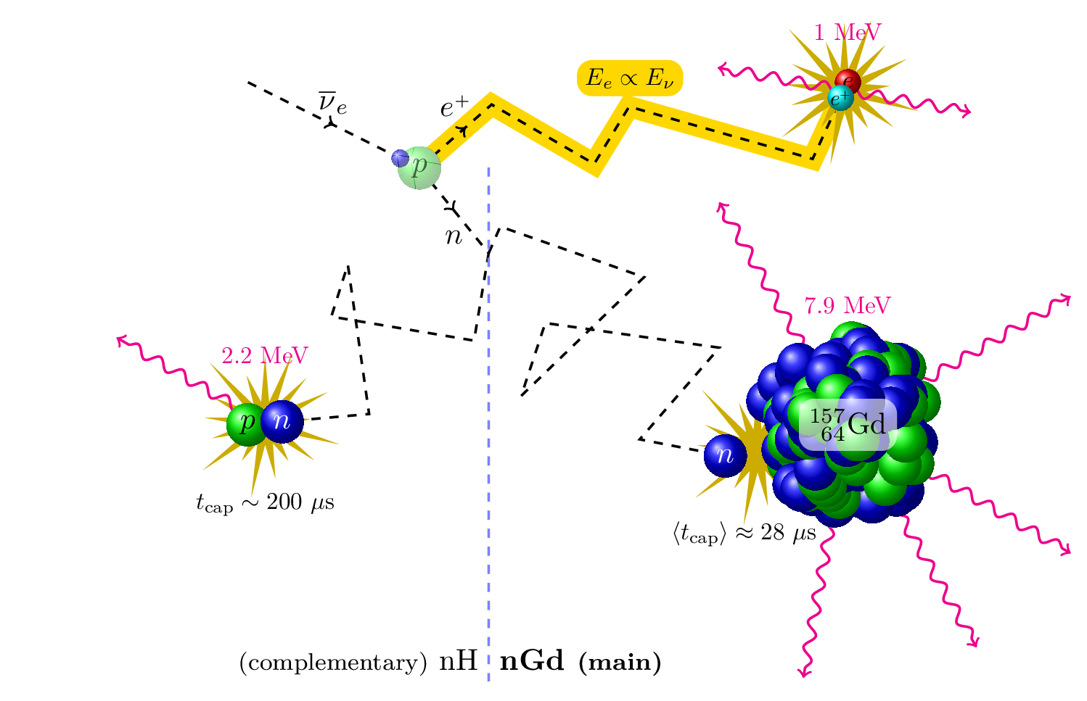
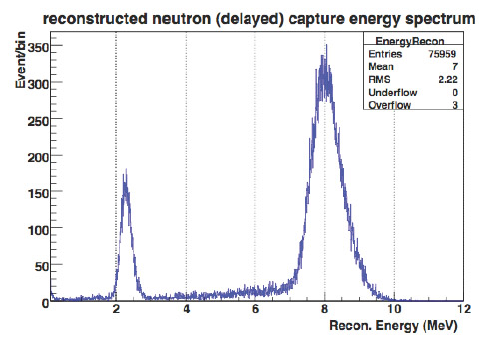
Reactor Neutrino Detection
Inverse-beta reaction (IBD)
Liquid scintillator technology
Capture on H
Capture on Gd
0.1% Gd
10-40 keV
1.8 MeV: Threshold

Slide 28
Principle of neutrino tomography
(1) Low energy neutrinos (MeV, GeV): oscillation tomography
Neutrino total numbers unchanged, flavor oscillates
下一代大型中微子探测器
(2) High energy neutrinos (>100 GeV): absorption tomography
Absorption effects change the total neutrino number
南极冰立方 (地中海、贝加尔湖中微子望远镜)

Slide 29
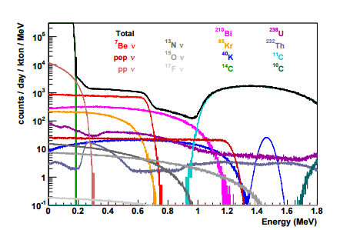
Oscillation tomography
太阳Be7中微子事例数(B8)：
每天5000-10000个 (50个)
能量：860 keV (10 MeV)
信号大小：0.1%-0.3% (5%)
分辨区域范围：30-50 km (200 km)
JUNO
Ioannisian, Smirnov

Slide 30
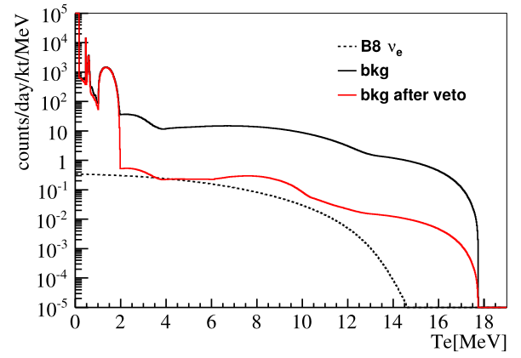
Oscillation tomography
事例数：每天50个
能量：5-15 MeV
信号大小：5%
分辨区域范围：~200 km

Slide 31
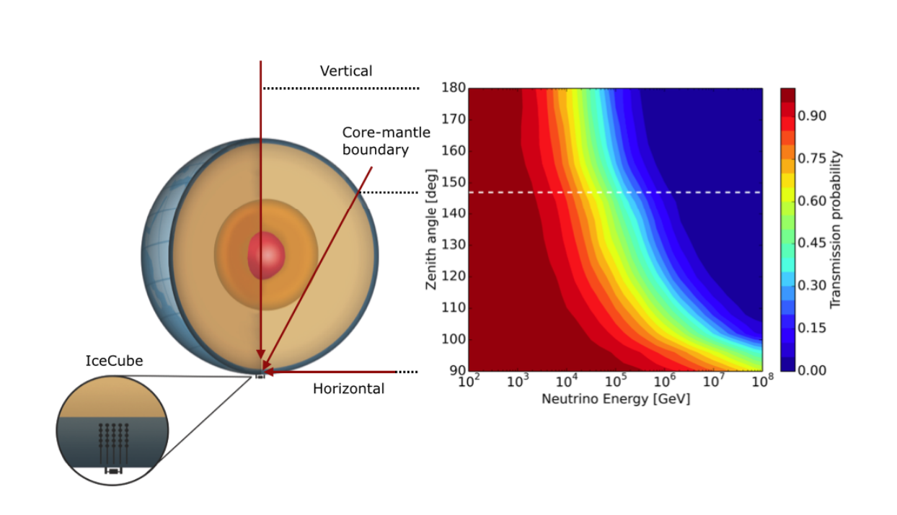
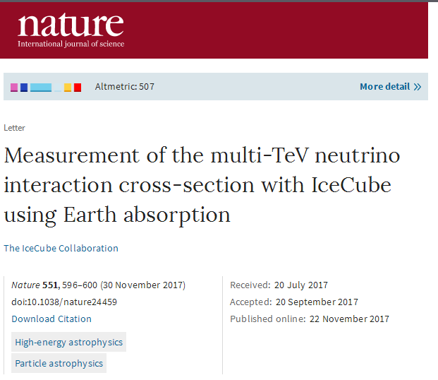
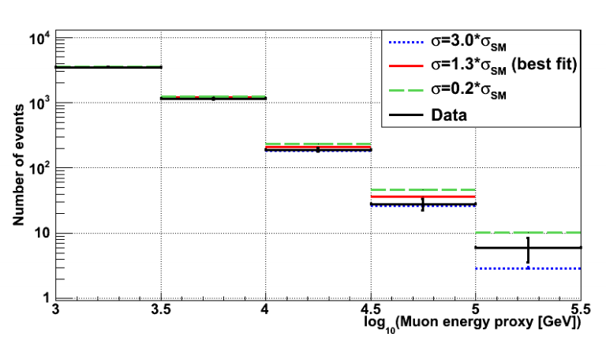
Absorption tomography
An interesting start for
Absorption tomography

