Slide 1
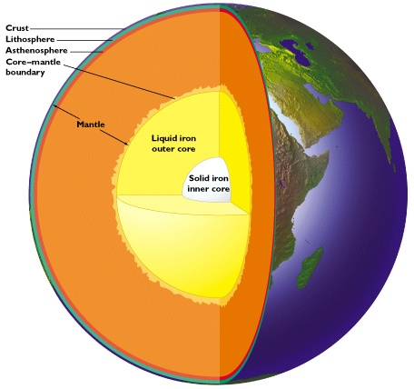
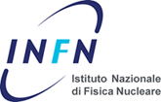
Geoneutrinos, JinPing and the Earth
Bill McDonough, *Scott Wipperfurth *Yu Huang and ⁺Ondřej Šrámek
Geology, U Maryland
Fabio Mantovani and *Virginia Strati,
Physics, U Ferrara and INFN, Italy
Steve Dye, Natural Science,
Hawaii Pacific U and Physics, U Hawaii
John Learned, Physics, U Hawaii
*graduate student
⁺post-doc
Notes:
The kTon-scale, underground, liquid scintillation detectors at KamLAND and Borexino, which measure the flux of electron antineutrino from the Earth (i.e., geoneutrino) and nuclear reactors, reveal that radiogenic heat from the decay of Th and U (only detectable signal) contributes between 20% and 50% of the Earth’s present-day power (46±3 TW). This year the SNO+ (Canada) detector comes on line and later this decade China's JUNO experiment, which is 20 times larger than the largest existing detectors, will likely begin counting. These particle physics experiments
are now establishing limits on acceptable compositional models for the Earth and defining the amount of nuclear power inside the Earth available to drive plate tectonics, mantle convection, and the geodynamo.

Slide 2
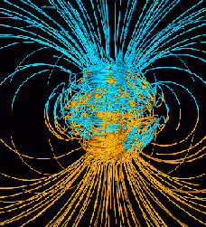
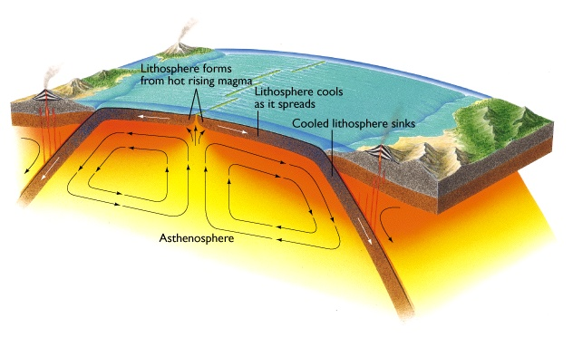
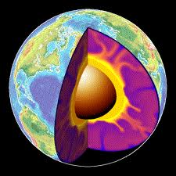
Plate Tectonics,
Convection,
Geodynamo
Radioactive decay driving the Earth’s engine!
K, Th & U!

Slide 3
5 Big Questions:
What is the Planetary K/U ratio?
Radiogenic contribution to heat flow?
Distribution of reservoirs in mantle?
Radiogenic elements in the core??
Nature of the Core-Mantle Boundary?
planetary volatility curve
secular cooling
whole vs layered convection
Earth energy budget
hidden reservoirs

Slide 4
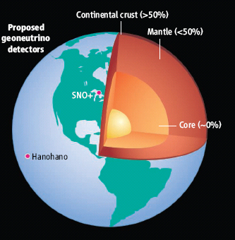
~13 ng/g U in the Earth
Metallic sphere (core)
<<<1 ng/g U
Silicate sphere
20* ng/g U
*O’Neill & Palme (2008) 10 ng/g
*Turcotte & Schubert (2002) 31 ng/g
Continental Crust
1300 ng/g U (~7 TW)
Mantle
~13* ng/g U (~13 TW)
U in the Earth:
[Th/U = 3.9, K//U = 1.3 x 10⁴]
*Mantle could have as little
1-3 TW or as much as 28 TW

Slide 5
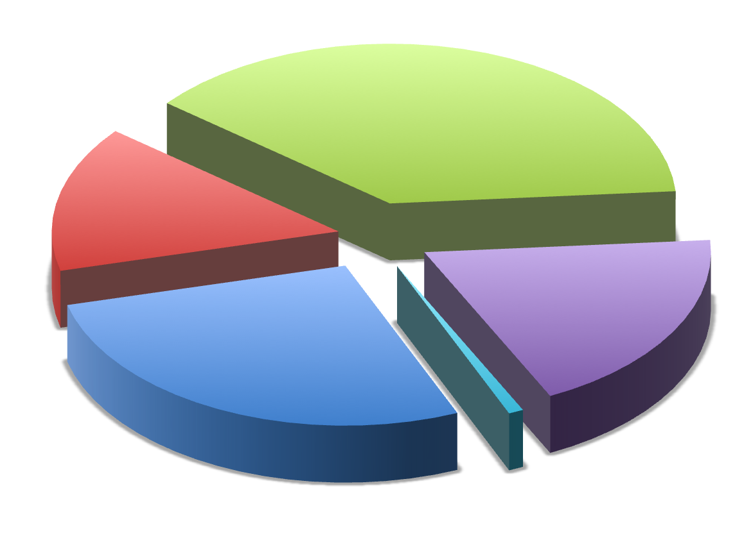
Earth’s surface heat flow 46 ± 3 (47 ± 1) TW
Mantle cooling
(18 TW)
Crust R*
(7 ± 1 TW)
(Huang et al ‘13)
Core
(~15 TW)
Mantle R*
(13 ± 4 TW)
(alternatively,
1 or 28 TW)
total R*
20 ± 4
*R radiogenic heat
(after McDonough & Sun ’95)
(0.4 TW) Tidal dissipation
Chemical differentiation
after Jaupart et al 2008 Treatise of Geophysics

Slide 7
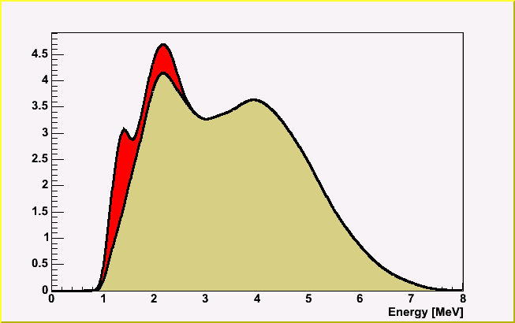
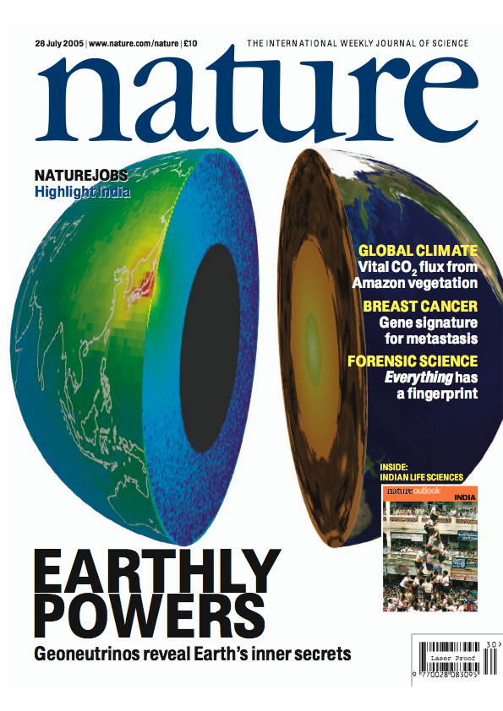
Reactor and Earth Signal
Geoneutrinos
KamLAND
Reactor Background
with oscillation
KamLAND was designed to measure reactor antineutrinos.
Reactor antineutrinos are the most significant contributor to the total signal.
Notes:
KamLAND was designed to detect reactor antineutrinos to measure the neutrino oscillation parameters. The picture shows the locations of KamLAND and all the nearby nuclear reactors. Nuclear reactors are indicated by the red-green dots. Naturally, the most significant background for geoneutrino detection is the antineutrinos from these reactors. The right plot shows the expected energy distributions of the geoneutrino spectrum and reactor background.

Slide 8
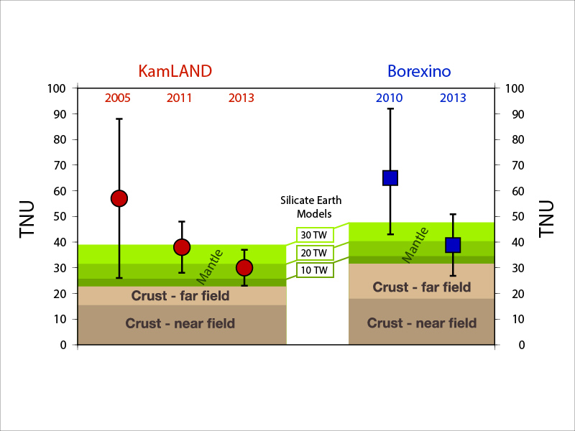
Summary of geoneutrino results
Silicate Earth MODELS
Cosmochemical: uses meteorites – 10 TW
Geochemical: uses terrestrial rocks –20 TW
Geodynamical: parameterized convection – 30 TW

Slide 9
Geoneutrino Flux on Earth Surface
Activity and number of produced geoneutrinos
Volume of source unit
Survival probability function
Abundance and density of the source unit
Distance between source unit and detector
Earth structure (ρ and L) and chemical composition (a)

Slide 10
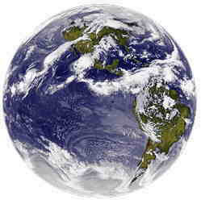
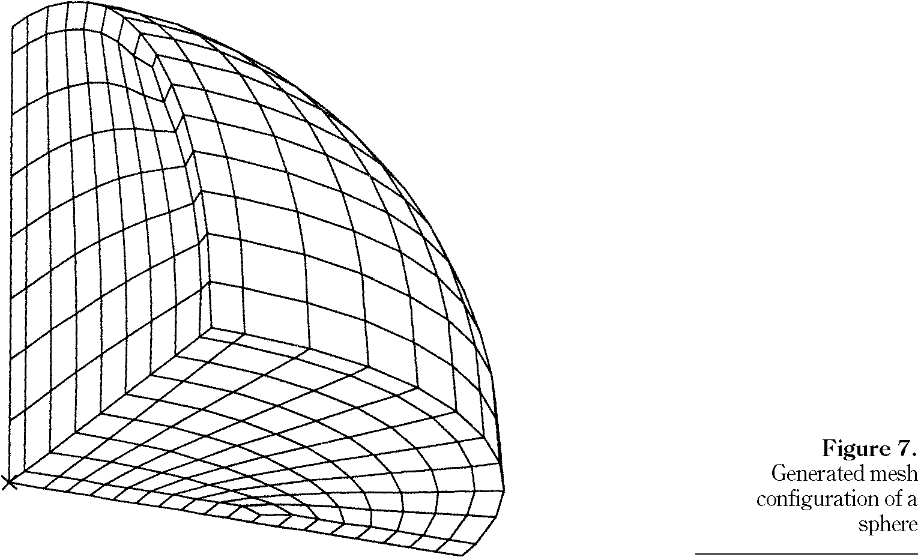
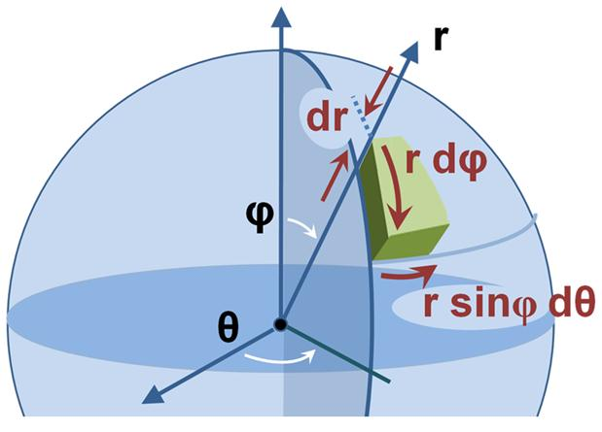
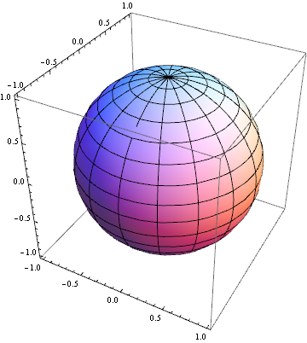
Constructing a 3-D reference model Earth
assigning chemical and physical states to Earth voxels

Slide 11
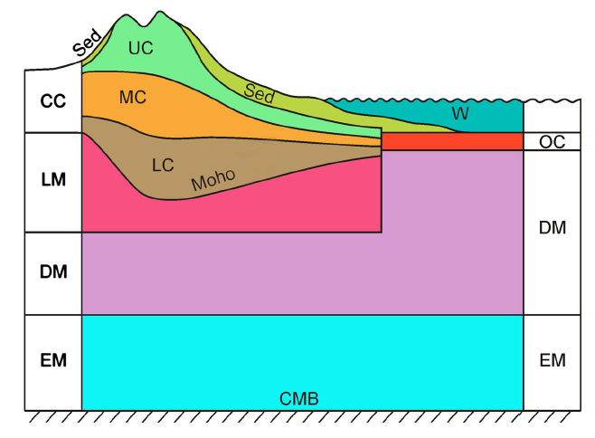
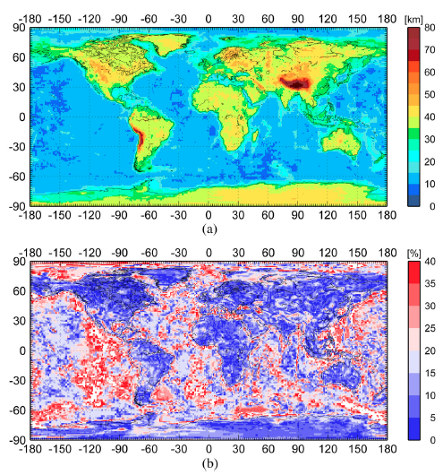
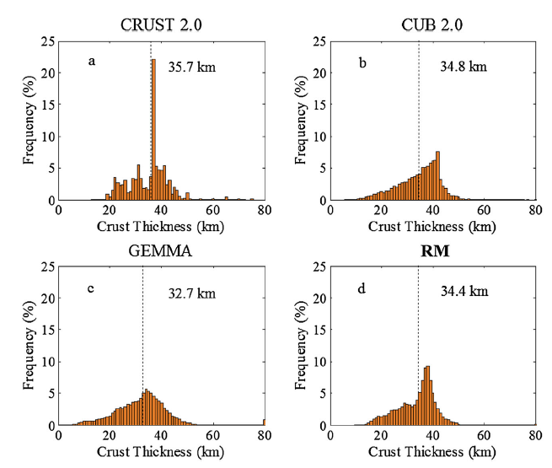
Huang et al (2013) G-cubed
Global Earth Reference Model
7 layers for the top 200 km
Integrate 3 global models for the crust
New crust model with uncertainties

Slide 12
Uranium Abundance in Middle Continental Crust layer
U_{MCC} (μg/g)
SNO+
BX
KL
JP
Average middle Cont. Crust U abundance is μg/g
Rudnick and Gao (2003) Treatise of Geochemistry 1.3 μg/g

Slide 13
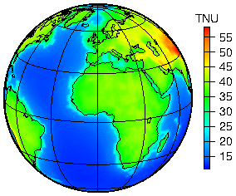
Predicted Global geoneutrino flux based on our new Reference Model
Huang et al (2013) G-cubed, 14:6, doi:10.1002/ggge.20129

Slide 14
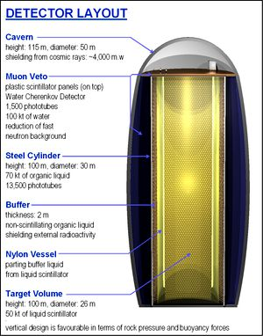
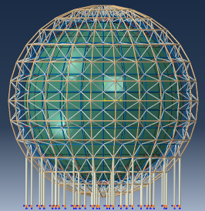
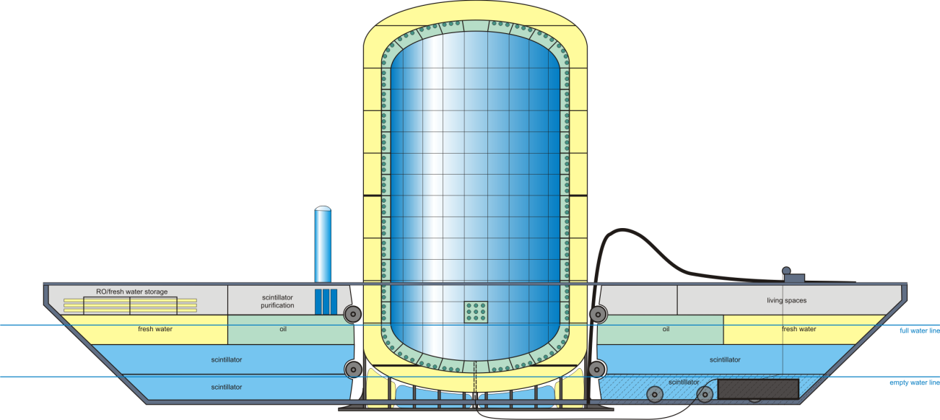
Future
detectors?
LENA,
EU
(50kt)
JinPing
next generation
many small detectors
one big one?
JUNO
China
(20kt)
Hanohano
International
ocean-based
(10kt)

Slide 15
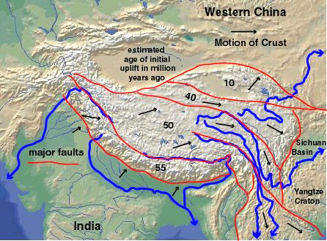
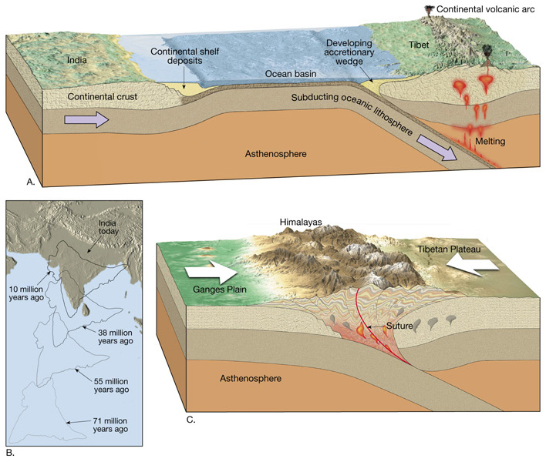
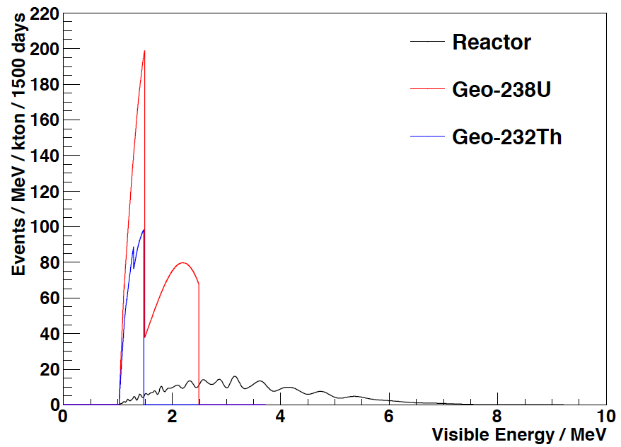
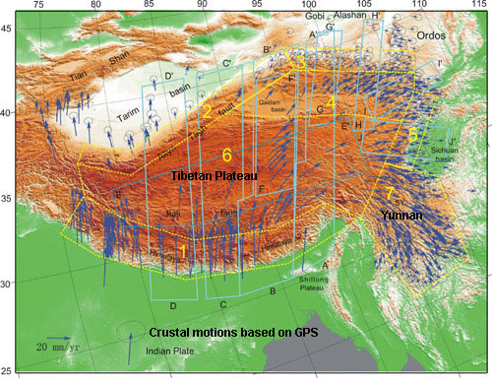
JinPing Geoneutrino Detector
Location is important!
Understanding the Earth
How the continents grow
How mountains move
Distribution of heat producing elements

Slide 16
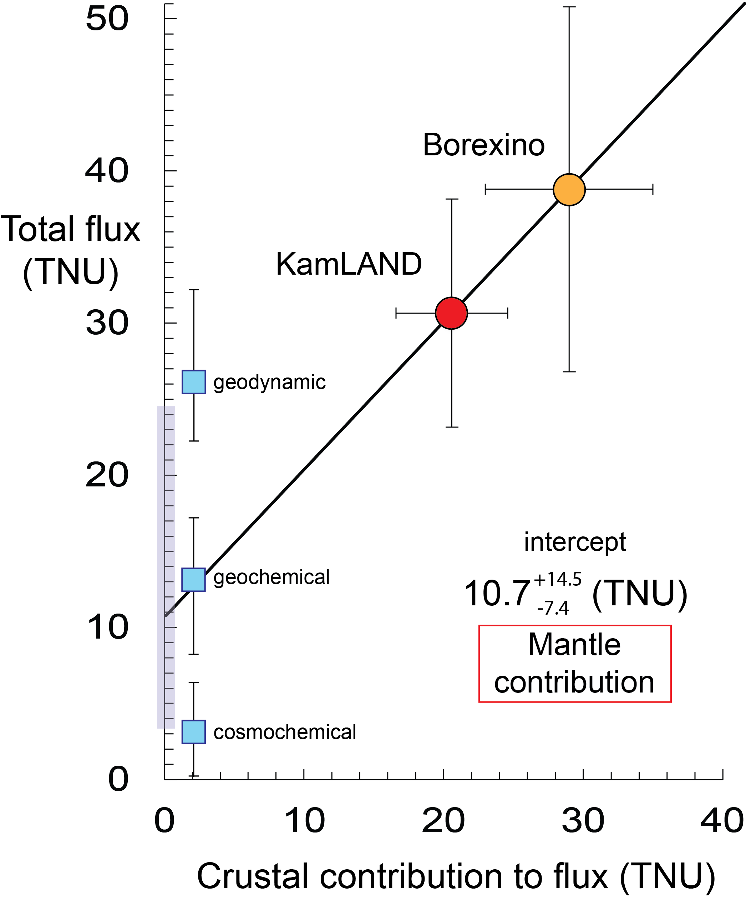
JinPing
Existing data
squeezing @ limit
coincidences of intercepts
Y-axis data is strictly from physics
X-axis data is strictly from geology
Intercept is mantle contribution
Hanohano

Slide 17
SUMMARY
Earth’s radiogenic (Th & U) power
22 ± 12 TW - Borexino 11.2 TW - KamLAND
Prediction: models range from 8 to 28 TW (for Th & U)
On-line and next generation GEO-NEUTRINO experiments:
SNO+ online 2015 ☺
JUNO: 2020, good experiment, big bkgd, geonu …
Hanohano: this is how to look at the mantle-only
*****
JinPing: 20XX, excellent experiment, low bkgd, big issues
+ 7.9
- 5.1
IMPORTANT CONSIDERATIONS: WbLS and directionality

