Slide 1
Structural option for the Jinping neutrino central detector
Contributor： Yuanqing Wang, Zongyi Wang
Speaker： Zongyi Wang
Department of civil engineering, Tsinghua University
2015-06-05
1

Slide 2
Outline
Introduction of the whole structure
Bearing capacity of the local joint
Introduction of the 1 t scale model
2

Slide 3
Introduction of the whole structure
Project introduction
The structure is placed at 2400 m underground. 500 t (×2) or 1000 t detecting liquid (density 0.8-1 g/cm³) is contained by an acrylic vessel and water with the density of 1.0 g/cm³ is outside the acrylic.
The acrylic vessel is supported by a stainless steel latticed shell.
Two alternative options:
(1) Cylindrical scheme
(2) Spherical scheme
3

Slide 4
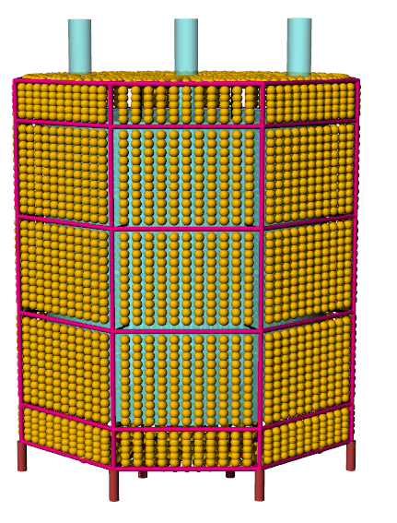
Introduction of the whole structure
Include PMT
No PMT
Cylindrical scheme (study in progress)
Diameter of acrylic vessel 11 m，height 11 m
Diameter of latticed shell 16 m，height 16 m
Fiducial capacity of the vessel 572 t
4

Slide 5
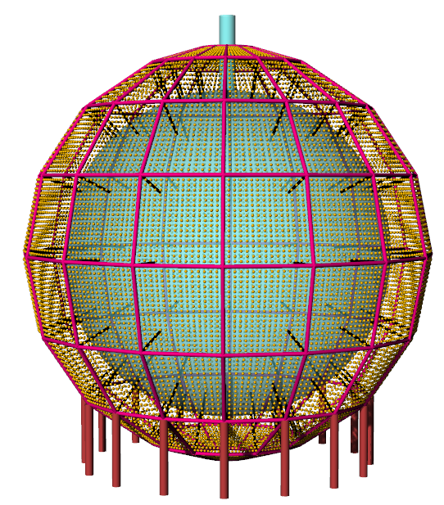
Introduction of the whole structure
Include PMT
No PMT
Spherical scheme (study in progress)
Diameter of acrylic ball 12 m
Diameter of latticed shell 17 m
Fiducial capacity of the vessel 523 t
5

Slide 6
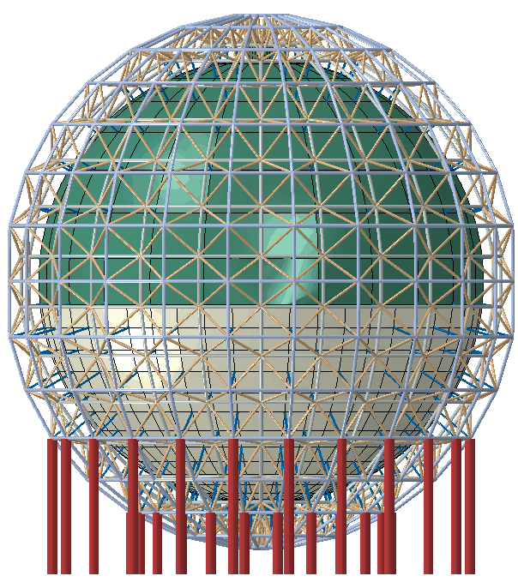
Design experience for JUNO central detector
At 700 m underground
Diameter of ball 35.5 m，thickness 120 mm
Diameter of stainless steel：inner 38.5 m，outer 40.5 m.
20 thousands of liquid scintillator (0.866g/cm³) inside, water outside (1g/cm³). 15,000 PMT mounted on the latticed shell.
Working condition:
Structural self weight + self weight and buoyancy of PMT + pressure difference on the acrylic ball
Acrylic vessel + double-layer stainless steel
6

Slide 7
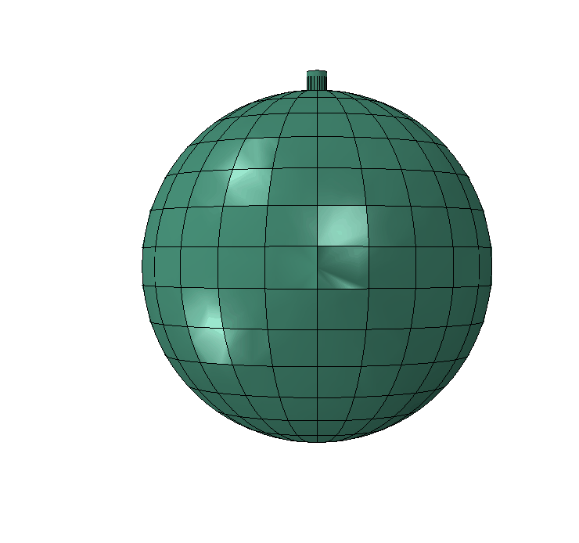
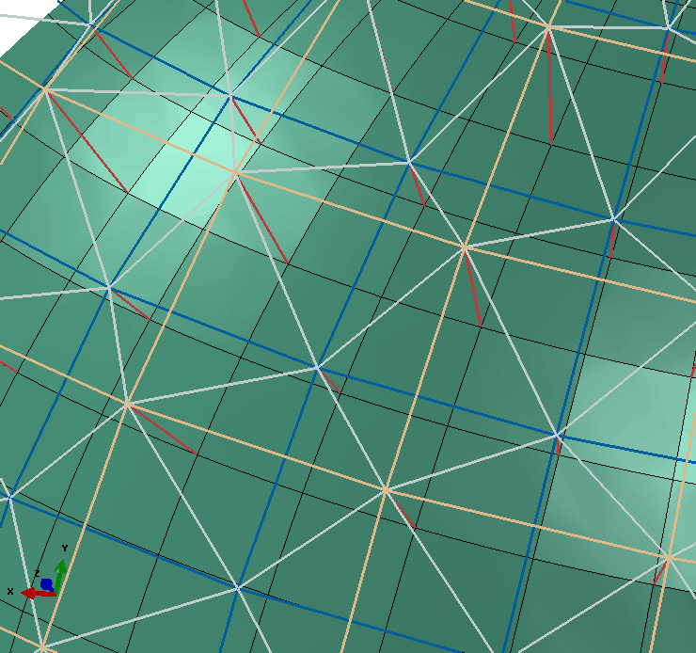
Design experience for JUNO central detector
Dividing method
Along the latitude line：24
Along the longitude line：15
The point on the inner latticed shell
The point on the outer latticed shell
Number of the braces: 564
Lighting-blocking rate: 1.8%
7

Slide 8
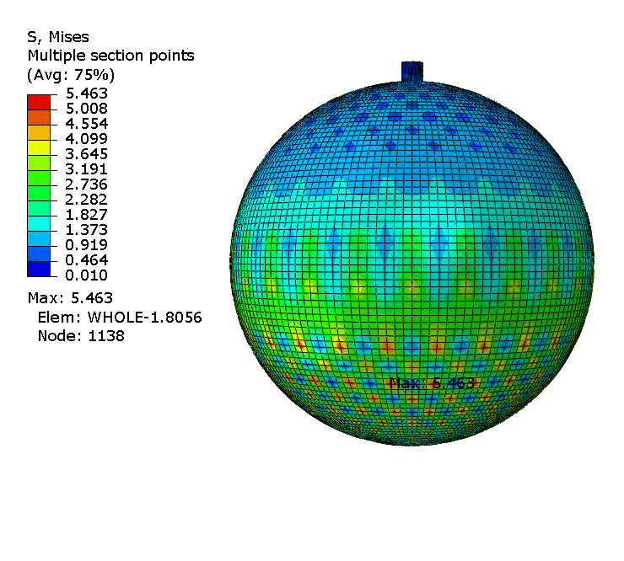
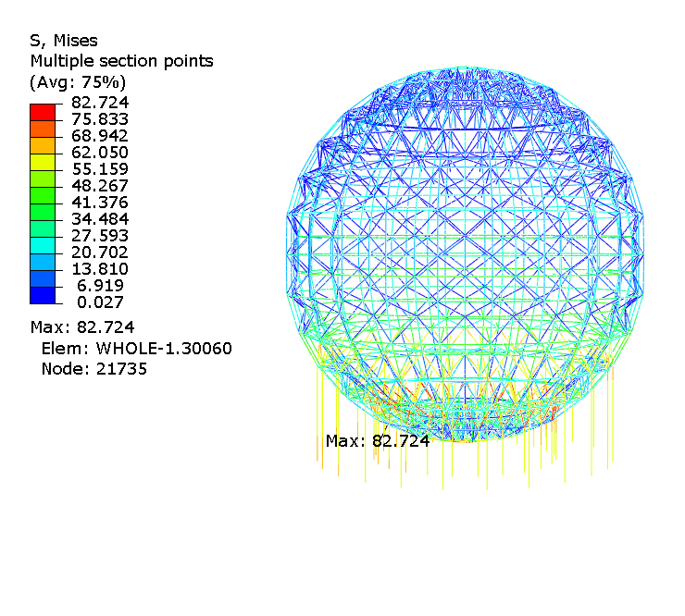
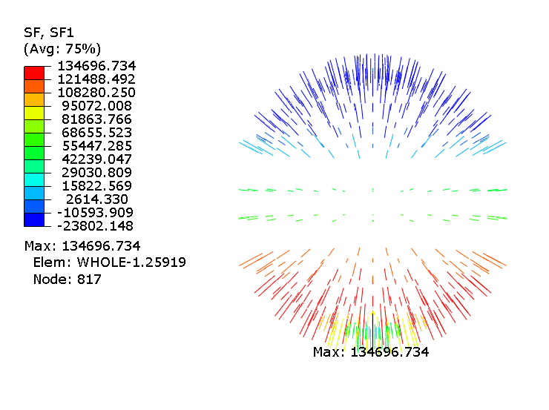
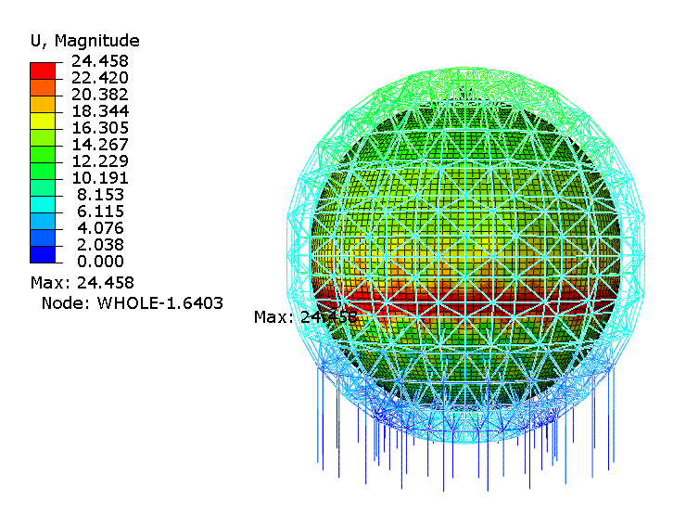
Design experience for JUNO central detector
The numerical model was created and evaluated using the ABAQUS
Maximum stress on the latticed shell: 82.7 MPa
Maximum stress on the ball: 5.4 MPa
Singular points excluded: 3.9 MPa
Maximum axial force of braces: 134.6 KN
Maximum displacement of structure: 24.5 mm
1/1428
Strength analysis
8

Slide 9
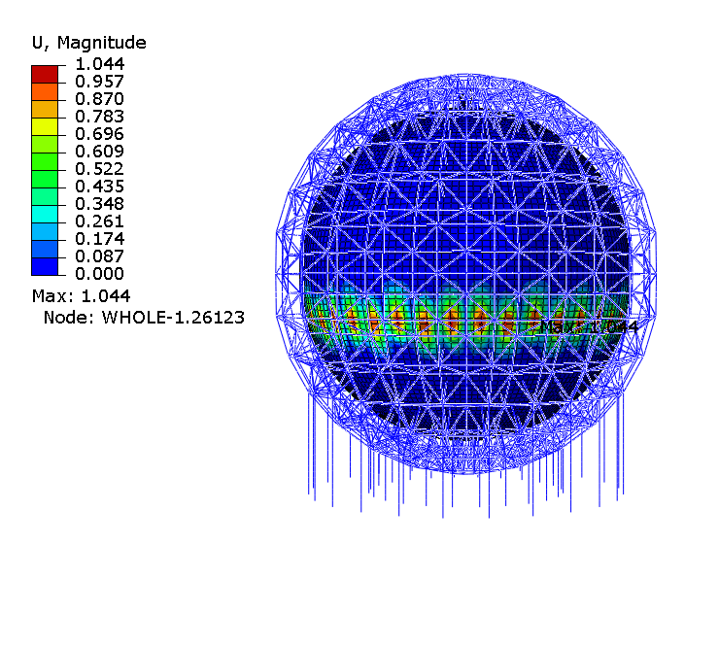
Design experience for JUNO central detector
Stability analysis
Material nonlinearity + geometric nonlinearity，
the initial imperfection is taken as 1/300 of the span.
Eigenvalue of the 1st buckling mode 4.3 > 4.2
Load factor 2.12 > 2.0
“Technical specification for space frame structures”
9

Slide 10
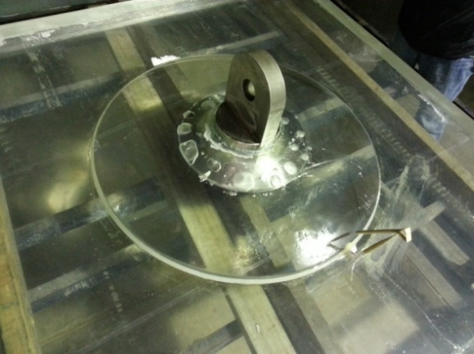
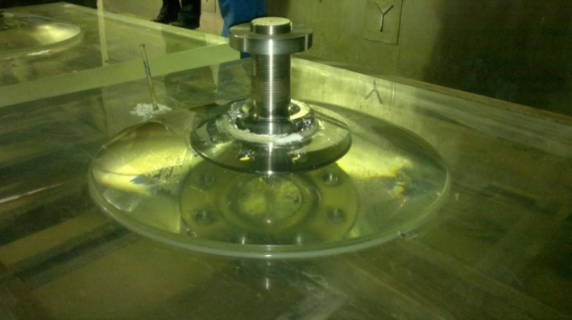
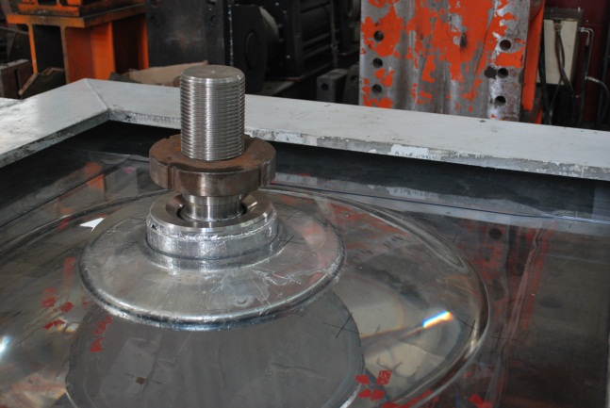
Bearing capacity of the local joint
Test purpose:
Bearing capacity
Deformation ability
Failure mode
Schematic diagram
Load in JUNO: 14 t
100 t tensile jack
Joint 1
Joint 2
Joint 3
10

Slide 11
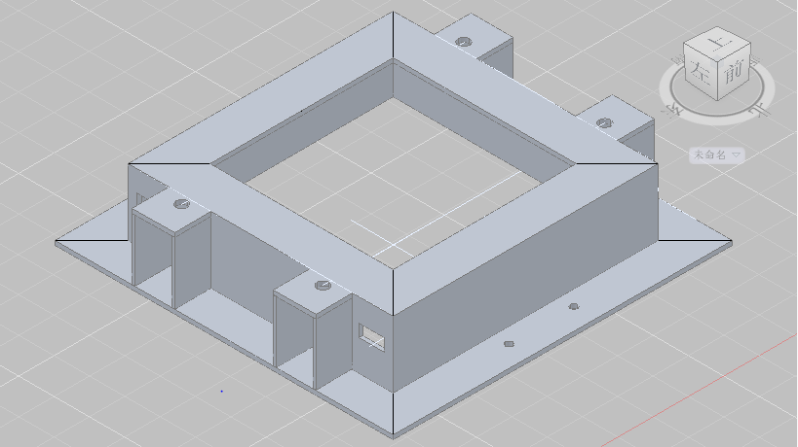
Fixing device
The width of the connecting area: 250 mm.
The reacting force was provided by four ground anchors.
Fixing device
11

Slide 12
Loading device
Joints 1 and 2
Joint 3
Installing error
Loads on Joints 1 and 2 were sideling--angle 5°.
To study the ultimate bearing capacity
Load was vertically upward
12

Slide 13
Comparison between test and FE results under 14 t
number | Comparative item | Measure point | Test result | FE result
Joint 1 | Stress (MPa) | A1-1 | 4.722 | 5.534
 |  | B5-1 | 3.954 | 1.476
 |  | C10-1 | 2.647 | 1.713
 | Displacement(mm) | W1-1 | 0.814 | 0.985
Joint 2 | Stress (MPa) | A8-2 | 2.525 | 2.909
 |  | B7-2 | 2.593 | 1.703
 |  | C13-2 | 2.461 | 2.580
 | Displacement(mm) | W2-2 | 0.625 | 1.032
Joint 3 | Stress (MPa) | A7-3 | 8.467 | 8.392
 |  | B7-3 | 3.479 | 2.963
 |  | C1-3 | 3.262 | 3.093
 | Displacement(mm) | W4-3 | 0.512 | 0.630
design load（14 t）
8.5 MPa, on the patched acrylic
3.4 MPa, on the main acrylic
Yield strength of acrylic: 50 MPa
Limit within 10 MPa
14

Slide 14
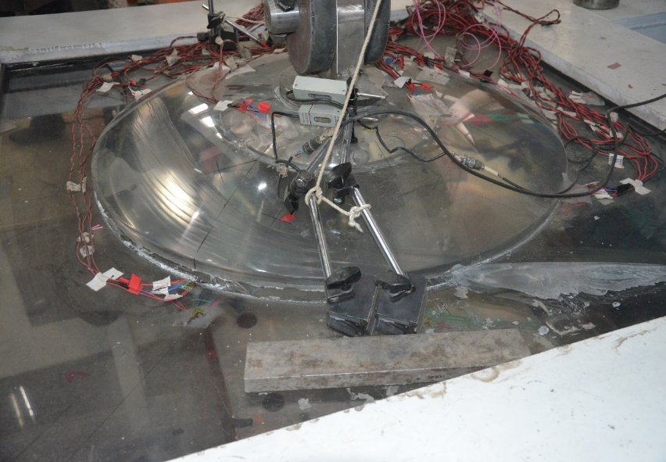
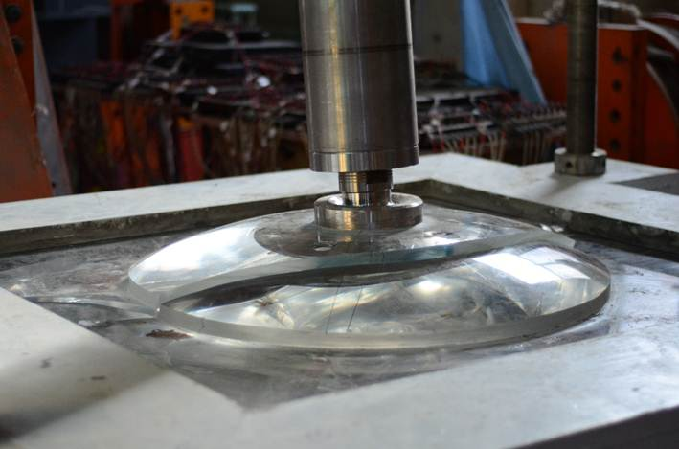
Failure picture
Joint 1
Joint 2
Ultimate bearing capacity 288 KN, 2 times the design value
Ultimate bearing capacity 325 KN, 2.3 times the design value
Ultimate bearing capacity 513 KN, 3.6 times the design value
Joint 3
13

Slide 15
Conclusion
Displacement values in these three joint tests are all very small (less than 2 mm).
  The test results of Joint 3 accord with FE results better. It shows that Joint 3 is less affected by initial defects and its stress distribution is more uniform.
  The ultimate strength of Joints 1, 2 and 3 are 28.8 t, 32.5 t and 51.3 t, respectively.
  The maximum axial force of braces of the Jinping central detector will be less than 14 t on account of its smaller scale. This kind of joint is reliable.
15

Slide 16
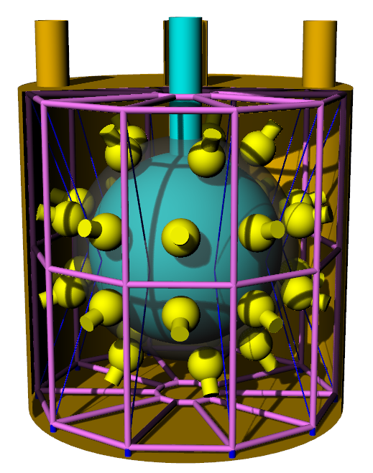
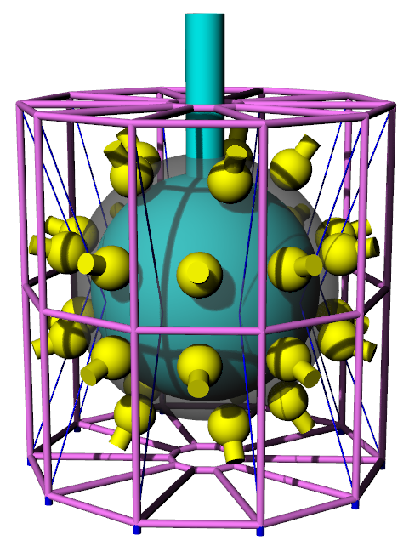
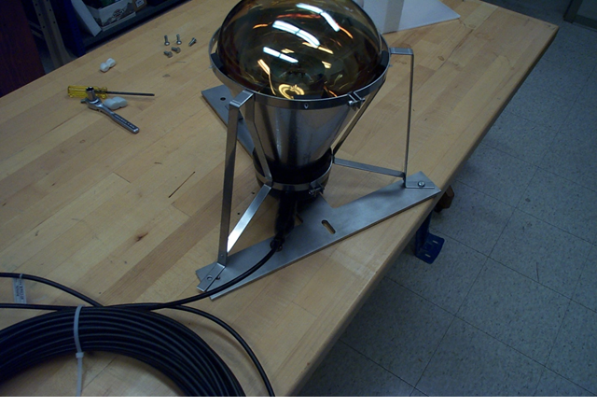
Introduction of the 1 t scale model
Black film
Support to fix PMT
Include tank
No tank
Diameter of acrylic ball 1.2 m
Diameter of stainless steel tank 2 m, height 2 m
Length of PMT 300 mm
Daya Bay
16

Slide 17
Thanks!

