Slide 1

Design Requirements for
Jinping Underground Neutrino Experiment
Neutrino experiment
Guanghua Gong
Dept. of engineering Physics, Tsinghua University
2015.06.05

Slide 2
Outline
Physics requirements
Detector concept
LS/Water/WbLS
Purification system
PMT
Electronics/Trigger/DAQ
Prototypes

Slide 3
Physics requirements
Fiducial mass
  >1Kt
Energy range:
  0.1MeV – 100MeV
Energy resolution:
  500 – 1000 PE/MeV
Directionality:
  20°for E> 5MeV
Particle identification
  Cherenkov and scintillation separation
  Gamma vs. electron vs. alpha-proton-nuclear-recoil
Calibration
  Energy response nonlinearity <1%
  Position reconstruction bias <1cm (@r=6m)

Slide 4
Detector(s) arrangement
130m tunnel
Option1: dual detectors
Option2: single detector
Depends on civil situation

Slide 5
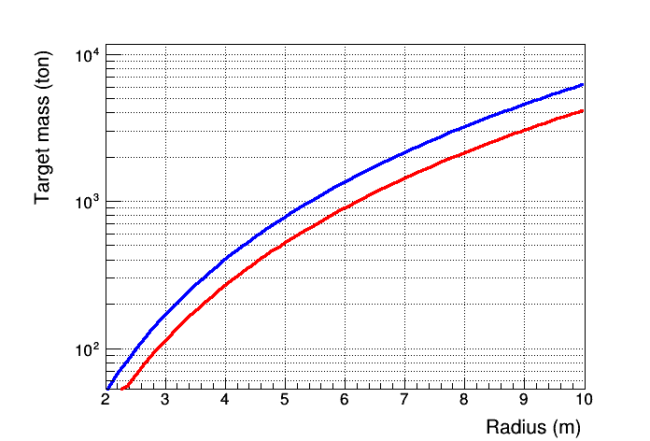
Target Mass: Sphere or Cylinder
Cylinder
Sphere

Slide 6
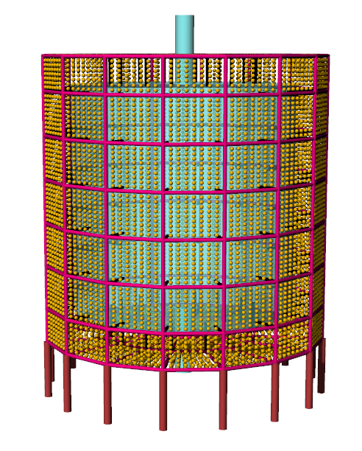
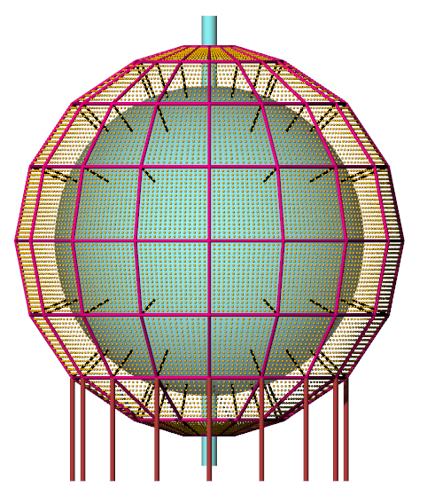
Detector concept
cylinder sphere

Slide 7
Major detector components
From inner to outer
Target material
Acrylic vessel
Water buffer
PMT
SS framework
Black shield
Veto PMT
Water buffer
Tyvek reflector
SS vessel

Slide 8
Target material
Assumptions
  PMT QE : 20% (35% for HQE PMT)
  Coverage: 50% ~ 80%
To reach 500~1000 PE/MeV resolution, light yield of target material
2000~10000 photons/MeV
Notes:
HQE with high dark rate

Slide 9
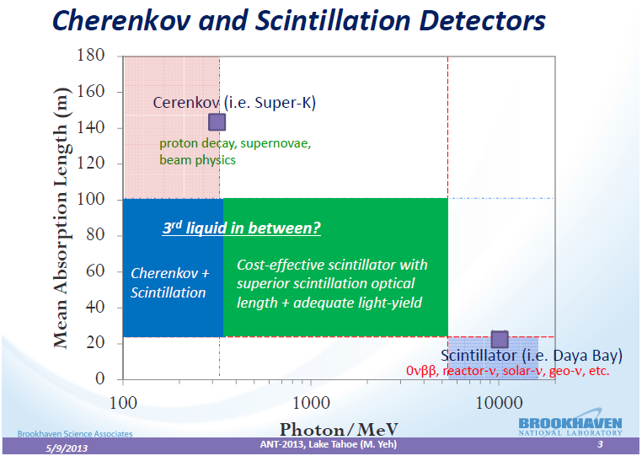
Target material : Water/LS/WbLS
Target range
  Minfang Yeh

Slide 10
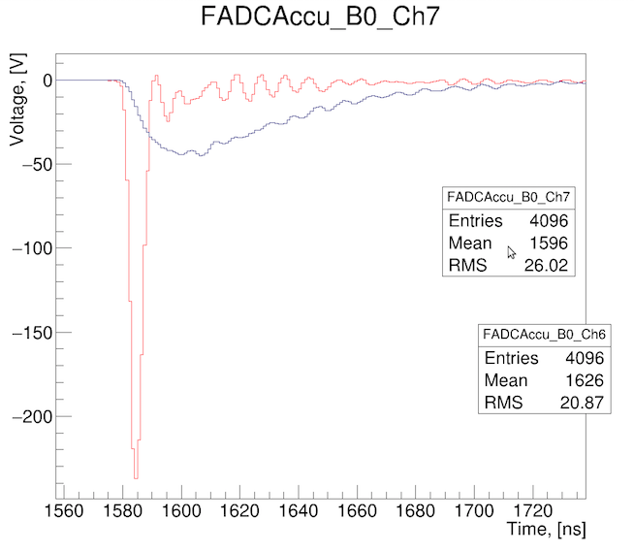
More information from WbLS
Cherenkov lights provide direction info. for charge particles.
  non-solar background suppression
  Electron/Photon separation
Cherenkov light must dominate in the 1st 10 ns over scintillation light
Scintillation requirement
  Light yield
  Ʈ > 100ns (if S=C in 10ns)
Slow scintillation light
fast Cherenkov light

Slide 11
PMT requirements
Dimension: 8” / 9” / 20”
QE: >20%
TTS: <5ns
  Related to the S/C separation
  Longer Ʈ of WbLS will relax the requirement
FWHM: <10ns
Low radioactivity background
Coverage: 50% ~ 80%
  2500(20”) ~ 15000(8”)

Slide 12
Calibration
Energy response non-linearity : <1%
  Position reconstruction bias: <1cm (@r=6m)
  (6.02/6)**3 -1 = 1%
Optical and radiation sources
Rope loop for 4-π deployment

Slide 13
Electronics/trigger/DAQ/DCS
FADC with 1Gsps/12b readout of each PMT
  Patten recognition, C/S separation
  information reconstruction, better event quality
Trigger-less scheme
  Self-trigger for each PMT, event selection by CPU
  PMT Dark noise and long scintillation lifetime
  Challenges for DAQ
Electronics under water
  Better signal quality
  Engineering challenges
    seal, cable/connectors, reliability

Slide 14
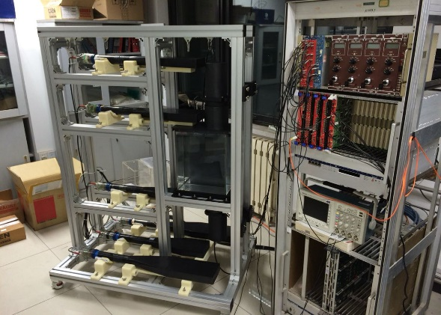
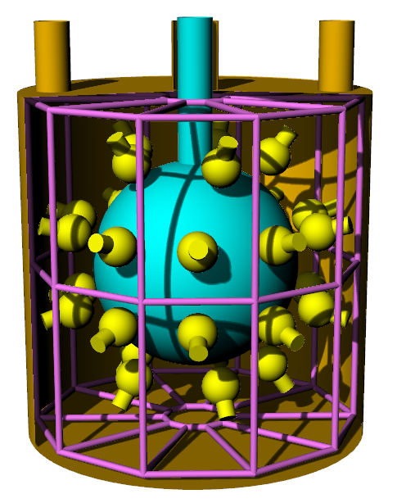
Prototype(s)
20L
1t
20t
2014
2015
2016
Cosmic with Telescope
Topic: WbLS Light yield
See Mohan’s talk
30PMT + WbLS
Topic:
α/β/γ separation,
Direction recon,
particle identification
Relocate able in container
200PMT + WbLS
Topic:
radioactivity background
PMT study,
Material purification
Engineering verification

Slide 15
Other topics
Purification
  Water / scintillator / nitrogen
Calibration
PMT protection
Magnetic shielding?
thermal environment / temp. control
Low radioactivity materials
Infrastructure
and many…..

Slide 16
Summary
CJPL-II provides great opportunity for low-background neutrino experiment.
Feasible conceptual detector design, detail scenario depends on civil situation
Major experimental requirements settled down
Prototypes testing are under going
Many aspects are not started ….

Slide 17
Thank you!

